Slide 1
Stock Market Forecasting Analysis Using Different Probabilistic and Machine Learning Models
Mohamed Afify
Abdullah Mousselli

Slide 2
Outline
Introduction
Data Selection and Preprocessing
Probabilistic Models:
- Bayesian Model
- Hidden Markovian Model
Stock New analysis
Investment Portfolio
Stock Prediction Using Machine Learning Algorithms
Stock Prediction Analysis using LSTM and GRU
Conclusion

Slide 3
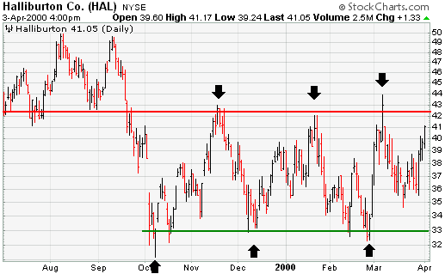
Introduction
Stock Price Evaluation
Statistical analysis using volume data
News analysis with sharp price increase
Price action direction movement
Support and resistance

Slide 4
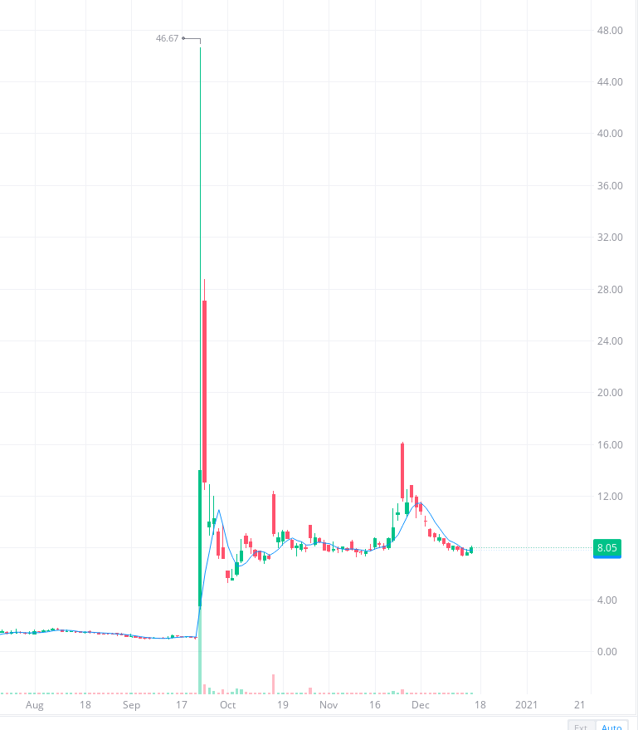
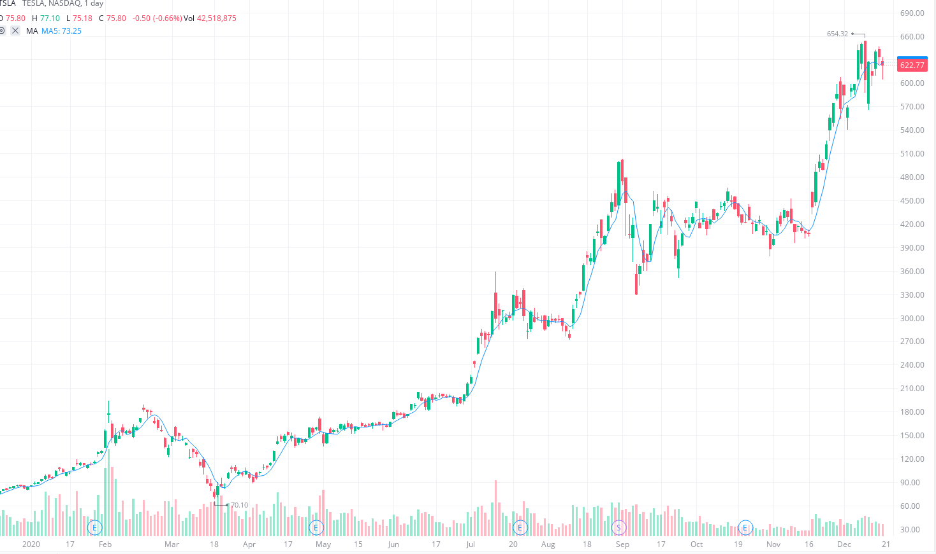
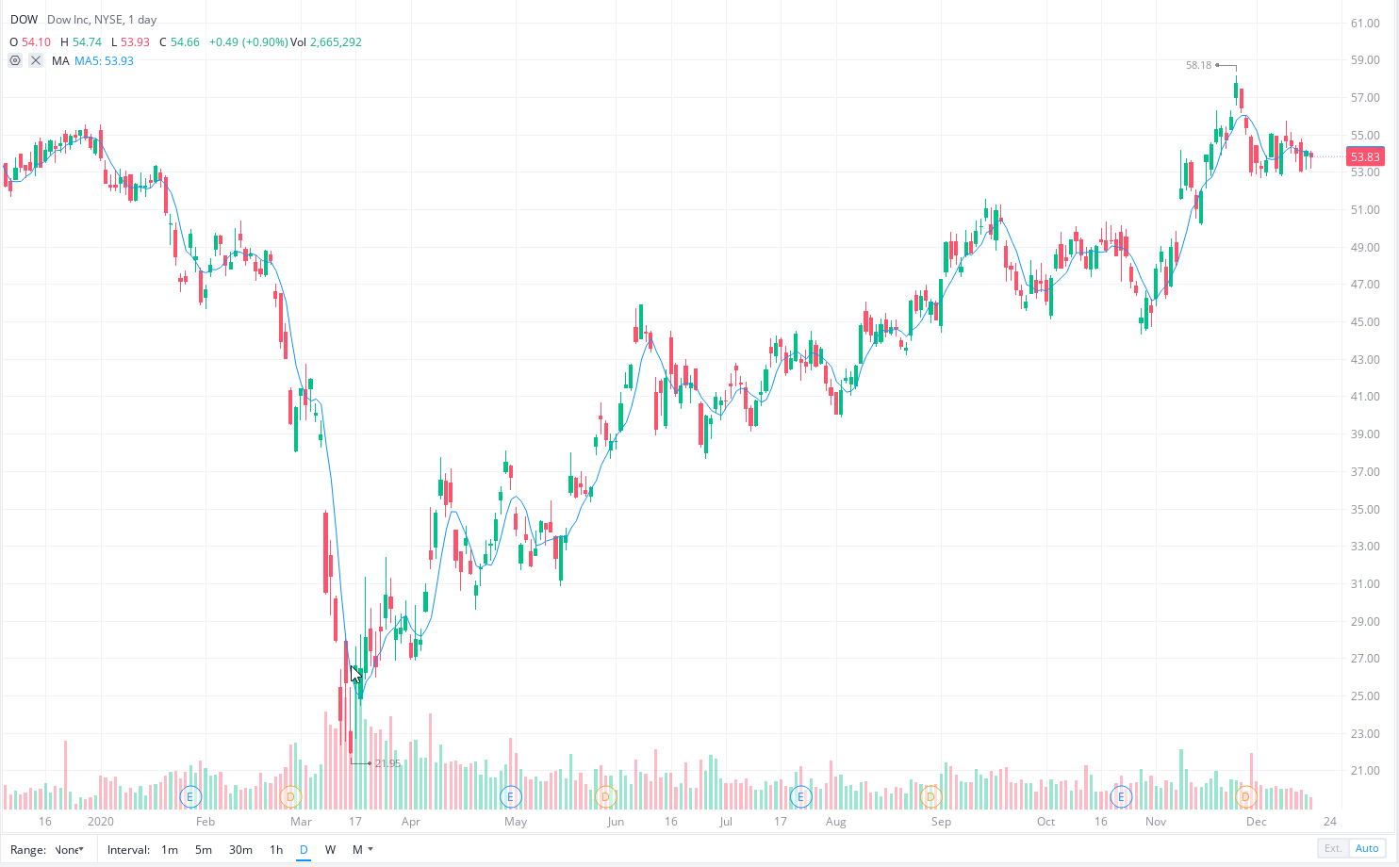
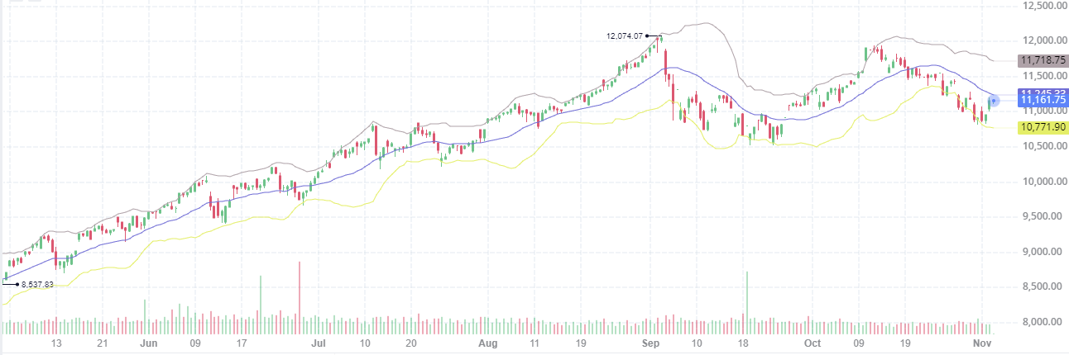
Data selection
Fundamental
Technical
Economy indicators
News

Slide 5
Data preprocessing
Price Change classifier (up, down)
date modification (Vacations, Weekend News, Missing data)
Fit data for Bayesian Model (0,1)
Slide window for future prediction (1 day data windowing)
Date | CI Price Index | UI | open | high | low | close | volume | MACD | boll | RSI | Class
1/7/2015 | 42.80 | 5.70 | 26.80 | 27.05 | 26.67 | 26.94 | 1.60E+08 | -0.01 | 26.85 | 26.85 | up
1/8/2015 | 42.80 | 5.70 | 27.31 | 28.04 | 27.17 | 27.97 | 2.37E+08 | 0.04 | 27.07 | 27.07 | up
1/9/2015 | 42.80 | 5.70 | 28.17 | 28.31 | 27.55 | 28.00 | 2.15E+08 | 0.07 | 27.23 | 27.23 | up
1/12/2015 | 42.80 | 5.70 | 28.15 | 28.16 | 27.20 | 27.31 | 1.99E+08 | 0.05 | 27.24 | 27.24 | down

Slide 6
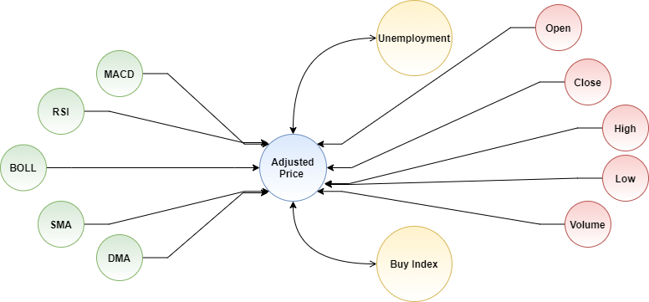
Bayesian Model
Data processed as 1 and 0
Using condition probability between each indicator and the Stock change Class
Train data and predict the price action versus prediction
Date | Consumer Price Index | Unemployment | open | high | low | close | volume | macd | macds | macdh | close_20_sma | close_20_mstd | boll | boll_ub | boll_lb | volume_delta | close_10_sma | close_50_sma | dma | adj close
2/28/2015 | 1 | 1 | 0 | 0 | 1 | 1 | 0 | 0 | 0 | 0 | 1 | 0 | 1 | 1 | 1 | 1 | 1 | 1 | 0 | 0
3/2/2015 | 1 | 1 | 0 | 0 | 0 | 1 | 0 | 0 | 0 | 0 | 1 | 0 | 1 | 1 | 1 | 1 | 1 | 1 | 0 | 1
3/3/2015 | 1 | 1 | 1 | 1 | 1 | 0 | 0 | 0 | 0 | 0 | 1 | 0 | 1 | 0 | 1 | 1 | 0 | 1 | 0 | 1
3/4/2015 | 1 | 1 | 0 | 0 | 0 | 0 | 1 | 0 | 0 | 0 | 1 | 0 | 1 | 0 | 1 | 1 | 0 | 1 | 0 | 0
3/5/2015 | 1 | 1 | 0 | 1 | 1 | 1 | 1 | 0 | 0 | 0 | 1 | 0 | 1 | 0 | 1 | 0 | 0 | 1 | 0 | 0

Slide 7
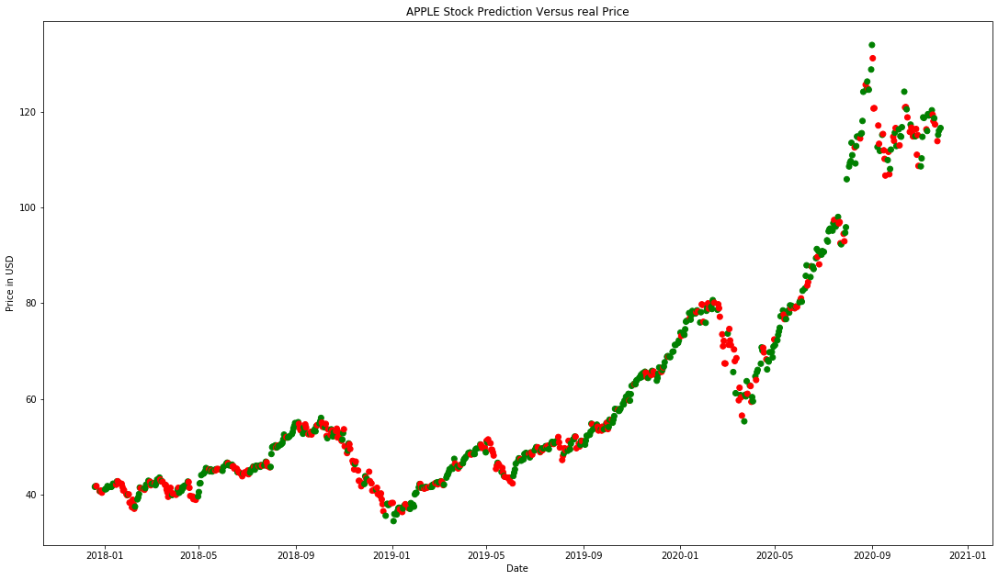
Model Results
Features | Down | UP
Price Index | 0.82 | 0.39
Unemployment | 0.71 | 0.46
Open | 0.27 | 0.45
Low | 0.36 | 0.48
High | 0.43 | 0.49
Close | 0.54 | 0.50
Volume | 0.47 | 0.50
MACD | 0.35 | 0.48
MACDH | 0.41 | 0.49
MACDS | 0.36 | 0.48
SMA | 0.56 | 0.50
BOLL | 0.46 | 0.50
BOLL UP | 0.56 | 0.50
BOLL DOWN | 0.51 | 0.50
MSTD | 0.57 | 0.50
Volume delta | 0.51 | 0.50
SMA 50 | 0.51 | 0.50
SMA 10 | 0.65 | 0.48
DMA | 0.42 | 0.49
Average Accuracy of 70%
Maximizing gain by 84.5%

Slide 8
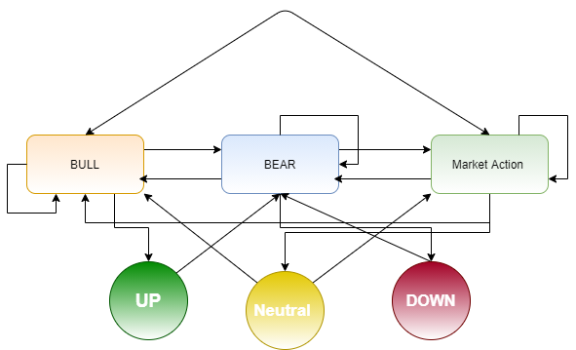
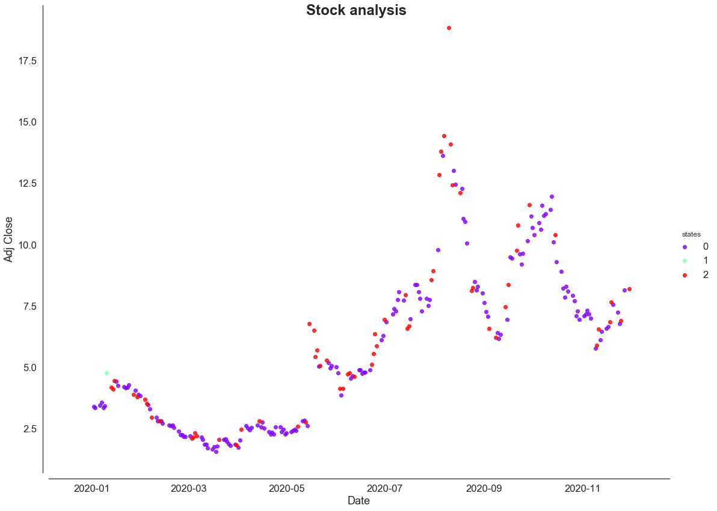
Hidden Markovian Model
3 hidden states of Bull, Bear and Others
3 Observed States of Up, Down and sideways
Added other indictors as up and down status
class.

Slide 9
Economic Indicators
Unemployment Rate
Price index per Month
We believe these indicators to influence the long-term investment (long-term forecasting methods)

Slide 10
Stock News Sentiment Analysis
forecast future trends of a certain stock indicator by using news headlines.
Each headline is classified as either Negative (Bad), Zero (Neutral) or Positive (Good).
news headline from Finaviz [Link]. The free account provides access to the last 100 news headline of each selected stocks.
Each headline was then analyzed using VADER (Valence Aware Dictionary for Sentiment Reasoning)
VADER sentimental analysis relies on a dictionary that maps lexical features to emotion intensities known as sentiment scores.

Slide 11
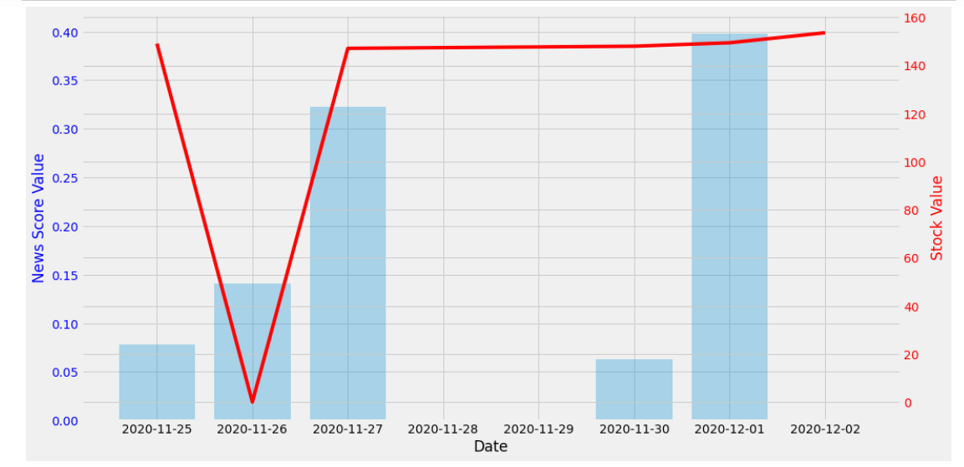
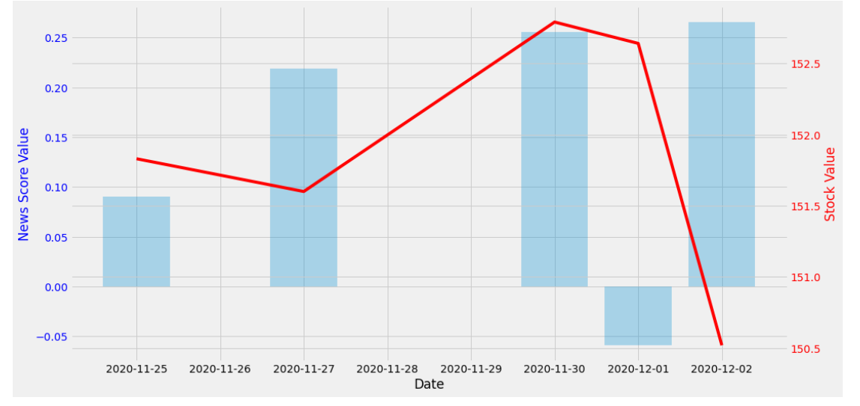
Stock News Sentiment Analysis
The sentiment score of a text can be obtained by summing up the intensity of each word in the text
VADER dictionary contains words for Stock news, and it is easy to update the library with new words as we needed to include words.

Slide 12
Investment Portfolio Analyzation and Optimization
Analyzing stock data for the last two years (starting from January 2018 up to December 2020) to determine the optimal percentage for each ticker in the investment portfolio.
We created a portfolio consisting of the 10 suggested companies (tickers) with equal percentages for each ticker and equals to 10%.

Slide 13
Investment Portfolio Analyzation and Optimization
Expected Return: which is a measure of the center of the distribution of the random variable that is the return.
Portfolio. Volatility: which is the degree of variation of a trading price series over time.
Sharpe Ratio: used to help understand the return of an investment compared to its risk. The ratio is the average return earned in excess of the risk-free rate per unit of volatility or total risk.
Expected return | 0.911
Volatility | 0.462
Sharpe Ratio | 1.797

Slide 14
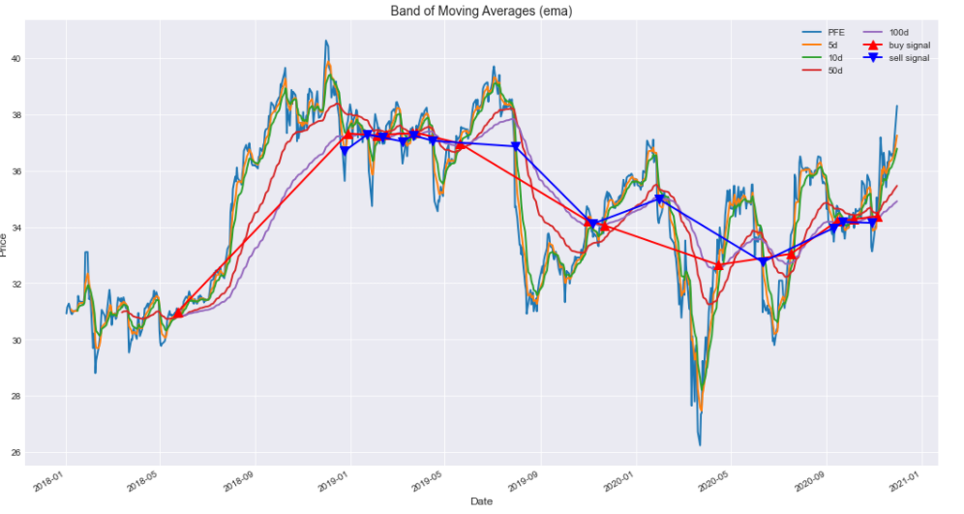
Investment Portfolio Analyzation and Optimization
Buy-sell signals for each ticker based on the moving averages (5-day, 10-day, 50-day, 100-day).

Slide 15
Investment Portfolio Analyzation and Optimization
Efficient Frontier: is the set of optimal portfolios that offer the highest expected return for a defined level of risk or the lowest risk for a given level of expected return.
Portfolios that lie below the efficient frontier are sub-optimal because they do not provide enough return for the level of risk.
Portfolios that cluster to the right of the efficient frontier are sub-optimal because they have a higher level of risk for the defined rate of return.
Time window/frequency | 734
Risk free rate | 0.08
Expected annual Return | 0.514
Annual Volatility | 0.332
Sharpe Ratio | 1.308
Time window/frequency | 734
Risk free rate | 0.08
Expected annual Return | 1.943
Annual Volatility | 0.713
Sharpe Ratio | 1.615

Slide 16
Investment Portfolio Analyzation and Optimization
AZN | 0.272357
PFE | 0.236112
AAPL | 0.0
NVDA | 3.469447e-18
MSFT | 5.854692e-18
TSLA | 0.000958
JPM | 0.0
BA | 1.322727e-17
WMT | 0.372915
DIS | 0.117658
AZN | 0.006855
PFE | 0.0
AAPL | 0.395786
NVDA | 8.147779e-17
MSFT | 0.019397
TSLA | 0.475793
JPM | 0.0
BA | 0.0
WMT | 0.102168
DIS | 0.0

Slide 17
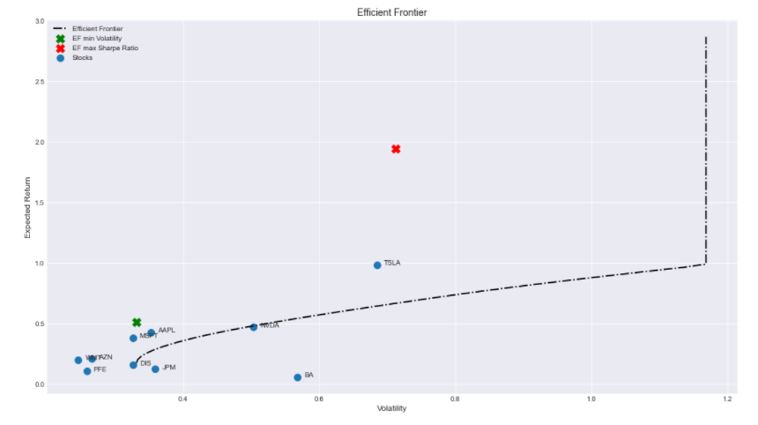
Investment Portfolio Analyzation and Optimization

Slide 18
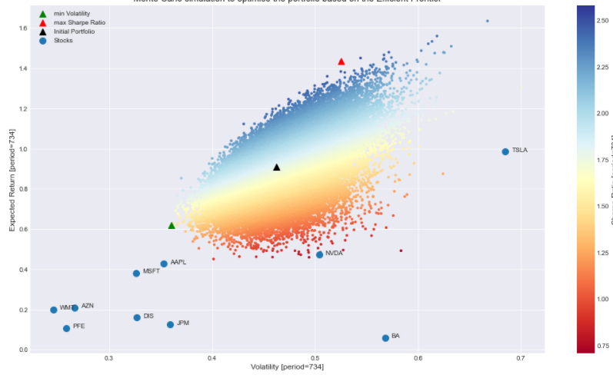
Investment Portfolio Analyzation and Optimization
Monte-Carlo simulation: we loop through 50000 possible portfolio and pick the one most suitable to the optimization preference (Minimum Volatility or Maximum Sharpe Ratio).

Slide 19
Stock Prediction Using Machine Learning Algorithms
each ticker that has 21 different features such as volume, macd, boll-up and other indicators that we produced in the Data preprocessing section to predict the trend of the stock as up “1” or down “0”
Naïve Bayes, Support Vector Machine, Logistic Regression, Neural Network, Nearest Neighbors, Gradient Boosting Classifier, Decision Tree and Random Forest.
check the correlation between the features.

Slide 20
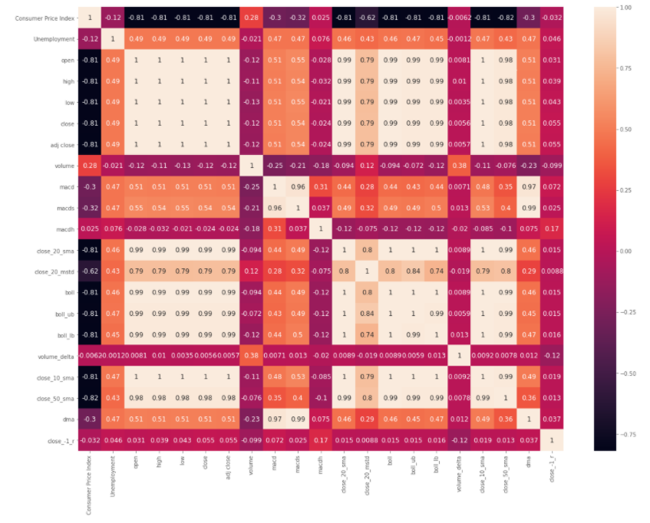
Stock Prediction Using Machine Learning Algorithms

Slide 21
Stock Prediction Using Machine Learning Algorithms
Classifier | Cross Validation Score
SVM | 51%
LR | 48%
NN | 46%
Naïve Bayes | 46%
Decision Tree | 46%
Random Forest | 45%
Gradient Boosting Classifier | 44%
KNN | 43%

Slide 22
Stock Prediction Using Machine Learning Algorithms
As we can see from the table above all classifiers performed poorly with SVM being the best with 51% score.
This can be due to the fact that some of the features used are much less important (very smaller coefficient value compared to others). A study should be conducted to analyze the effects of each feature and determine the weights for each feature or maybe some features were not correlated correctly further investigation for improvement is required.

Slide 23
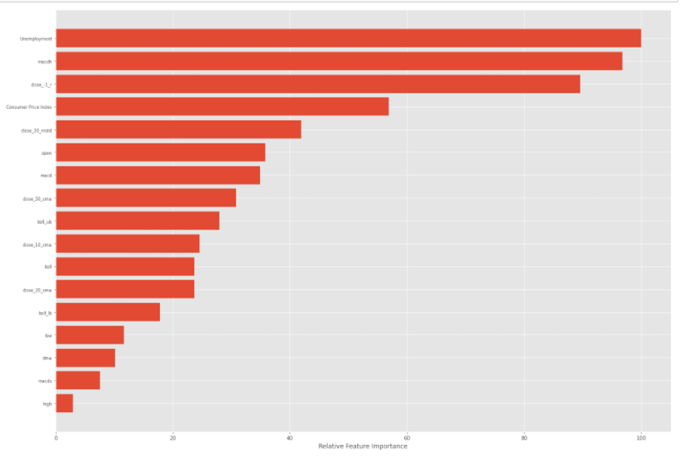
Stock Prediction Using Machine Learning Algorithms

Slide 24
Stock Prediction Analysis using LSTM and GRU
time-series problem where we look back to a period of time in our case, we tried many and settled with the best result (60 days).
Each time series has 18 features we dropped the (close, adj close, volume) to avoid overfitting where the model basically looks at the value (Data leakage) a problem that most of the LSTM stock prediction models online suffers from.
Using this approach, we were able to achieve accuracy around 70% for all tickers and was the most 76% for LSTM model on Apple stock. While we applied cross validation to check for overfitting and data leakage it is premature to say that the accuracy is 100% correct as more investigation is required to confirm this percentage.

Slide 25
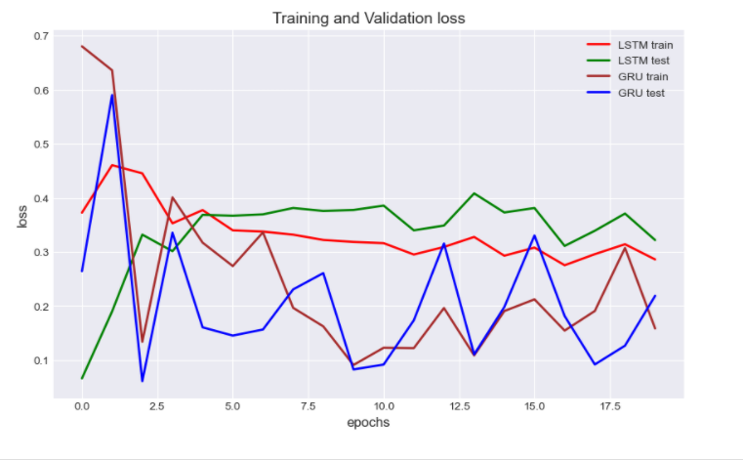
Stock Prediction Analysis using LSTM and GRU

Slide 26
Conclusion
Real-time stock news sentiment trend analysis model showed that the model performed good on mostly all the suggested tickers.
Preformed significantly better for companies that run on news (specially bio companies with small market capital).
The model performed bad on companies that have low amount of daily news which is understandable as the news headlines are the only feature the model is basing its predictions on.
This project also showcased the importance of analyzing and optimizing the investment portfolio using optimization methods like Efficient Frontier and Monte-Carlo simulation to pick the best investment portfolios based on historical information.

Slide 27
Conclusion
Classifying the stock trend using Machine learning methods were significantly worse than using the probabilistic modeling techniques.
This can be either due to feature correlation as pre-training weights needs to be assigned or it can mean that these algorithms are not suitable for stock trend classification.
As we approached this problem as a time-series model with LSTM and GRU we were able to significantly improve the results. However, it is premature to determine that this improvement was accurate only based on the experiments we conducted.

